Slide 1
TRANSMISSION MODE & PHYSICAL LAYER -by Hitesh Nautiyal

Slide 2
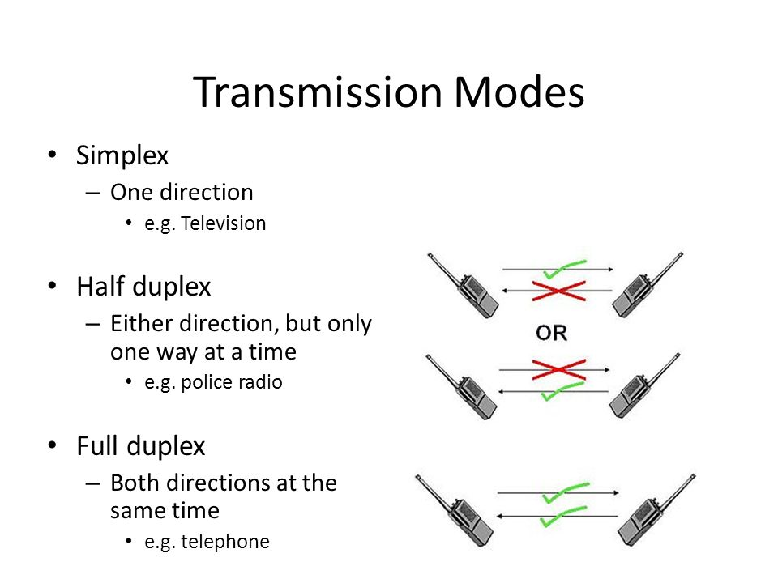
Transmission Modes/Communication Modes:-

Slide 3
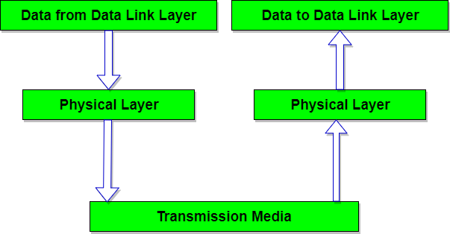
PHYSICAL LAYER :-
Physical layer is the lowest layer of the OSI reference model. It is responsible for sending bits from one computer to another. This layer is not concerned with the meaning of the bits and deals with the setup of physical connection to the network and with transmission and reception of signals.

Slide 4
Functions of Physical Layer :-
Representation of Bits: Data in this layer consists of stream of bits. The bits must be encoded into signals for transmission. It defines the type of encoding i.e. how 0's and 1's are changed to signal.
Data Rate: This layer defines the rate of transmission which is the number of bits per second.
Synchronization: It deals with the synchronization of the transmitter and receiver. The sender and receiver are synchronized at bit level.
Interface: The physical layer defines the transmission interface between devices and transmission medium.
Line Configuration: This layer connects devices with the medium: Point to Point configuration and Multipoint configuration.
Topologies: Devices must be connected using the following topologies: Mesh, Star, Ring and Bus.
Transmission Modes: Physical Layer defines the direction of transmission between two devices: Simplex, Half Duplex, Full Duplex.
Deals with baseband and broadband transmission.

Slide 5
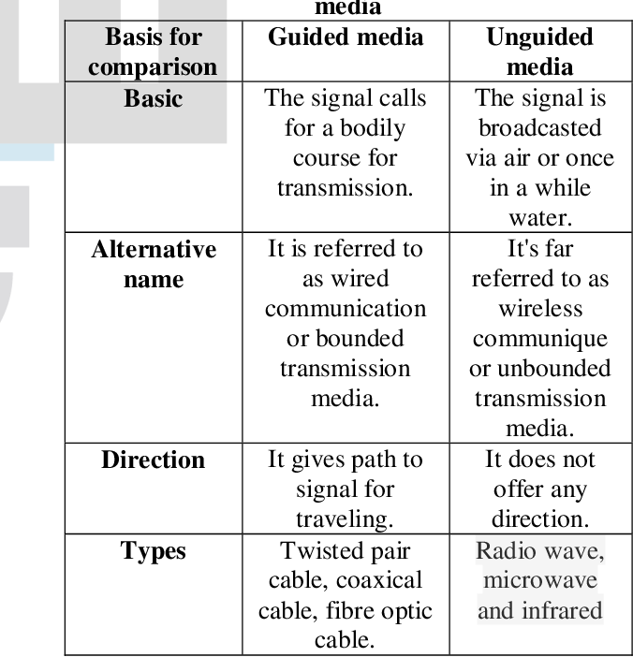
Guided & Unguided Media :-

